Slide 1


Smart Market
Bilal Alhilal Alsharifi
Osama Slik
Lama Mawazini
Leen Alhamwi
Supervised by:
Dr. Basem Kosaiba
Eng. Muhammad Alsati

Slide 2
Contents
The
Idea
Intro to Android
The problem
Theoretical
Background
Implementation
Future Plans

Slide 3




The Problem!

Slide 4




The Problem!
Wow! I’ll download this game later

Slide 5
The Problem!
English

Slide 6
The
Idea
Intro to Android
The problem
Contents
Future Plans
Theoretical
Background
Implementation

Slide 7



The Idea
Apps suggestion
Multilingual
New creative marketing ideas
No restrictions
Voice input

Slide 8
Intro to Android
Theoretical
Background
The
Idea
Contents
Implementation
Future Plans
8
8
8

Slide 9





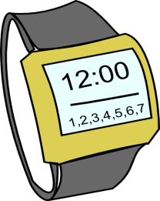



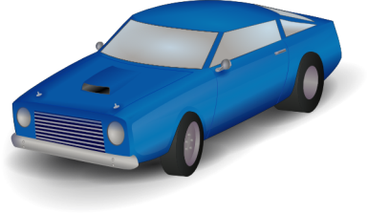
Intro To Android

Slide 10
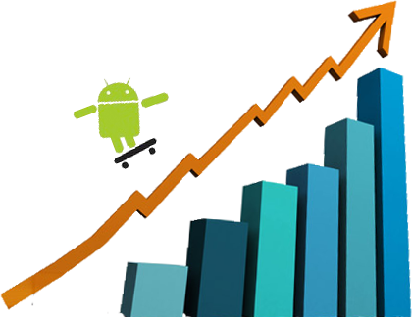

Intro To Android
400m
total activations
1m
daily activations

Slide 11
Theoretical
Background
Implementation
Intro to Android
Contents
Future Plans
11
11
11
11

Slide 12
Theoretical Background
Collaborative Filtering

Slide 13
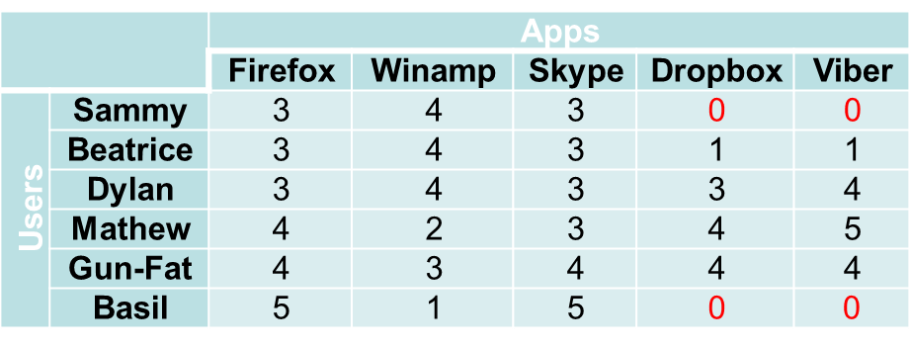
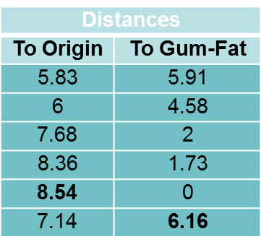
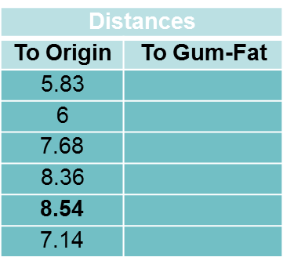
Theoretical Background
Kmeans
c1
c2

Slide 14
Theoretical Background
Kmeans
Basil | Gun-Fat | Mathew | Dylan | Beatrice | Sammy
6.16 | 0 | 1.73 | 2 | 4.58 | 5.91 | C1
0 | 66.1 | 6.85 | 6.48 | 4.35 | 4.12 | C2

Slide 15
Theoretical Background
Kmeans
users

Slide 16
Theoretical Background
Kmeans
Apps
Viber | Dropbox | Skype | Winamp | Firefox
0 | 0 | 3 | 4 | 3 | Sammy | Users
1 | 1 | 3 | 4 | 3 | Beatrice
4 | 3 | 3 | 4 | 3 | Dylan
Notes:
Disadvantages:
Slow
No features

Slide 17
Theoretical Background
Content-Based Recommender System

Slide 18
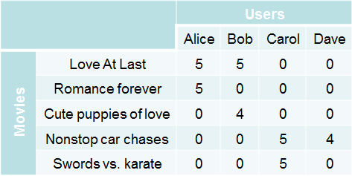
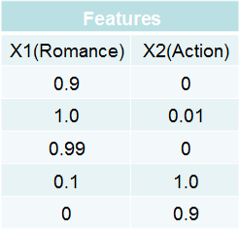
Theoretical Background
Gradient Descent
Y
X
18

Slide 19
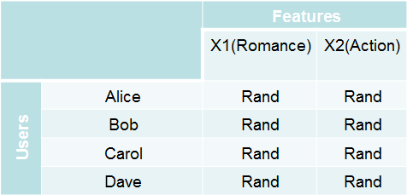

Theoretical Background
Gradient Descent
$$θ$$

Slide 20

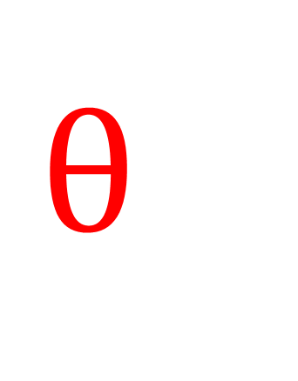
Theoretical Background
Gradient Descent
Y
$$θ$$
X
20

Slide 21
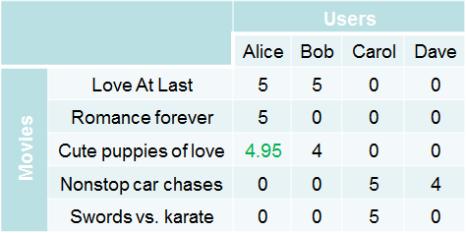
Theoretical Background
Gradient Descent
$θ^{1}= \begin{matrix}5 & 0\end{matrix}$, $x^{3}=\begin{matrix}0.99 & 0\end{matrix}$
(θ¹)T x³ = (5 * 0.99) + (0 * 0)= 4.95
21
Notes:
Features : categories, developer id, installs, rate*ratesCount

Slide 22
Implementation
Future Plans
Theoretical
Background
Contents
22
22

Slide 23
Implementation
Used Techniques
Web services

Slide 24







Implementation
Used Techniques
Web service

Slide 25
Implementation
Used Techniques
Multi-threading

Slide 26



Implementation
Used Techniques
UI thread
Worker thread 1
Worker thread 2

Slide 27
Implementation
Used Techniques
Integration Layer

Slide 28




Implementation
Used Techniques

Slide 29
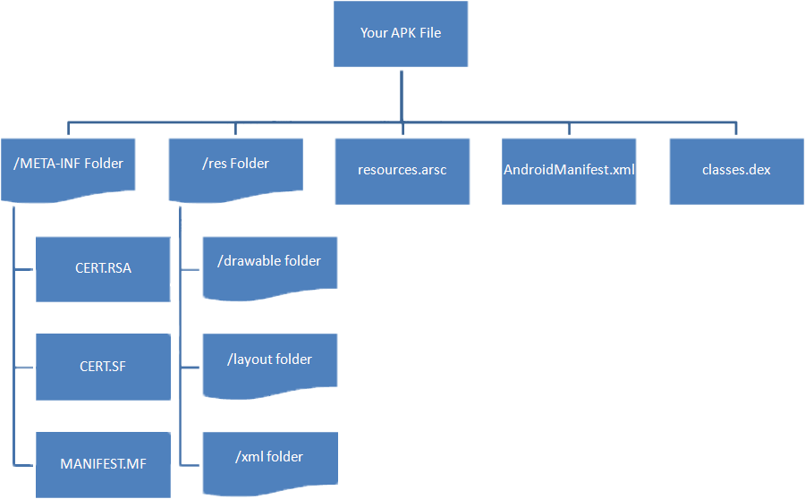
Implementation
Used Techniques

Slide 30
Implementation
Used Techniques
NFC technology

Slide 31


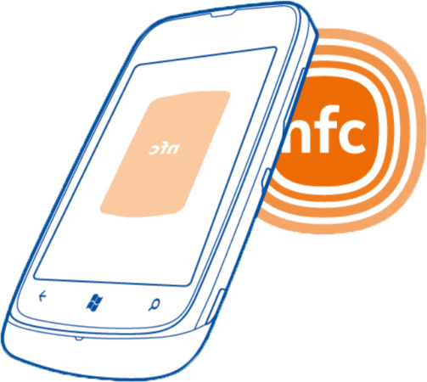
Implementation
Used Techniques
4 cm
Two devices
Devices & tag

Slide 32
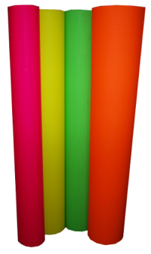
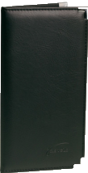



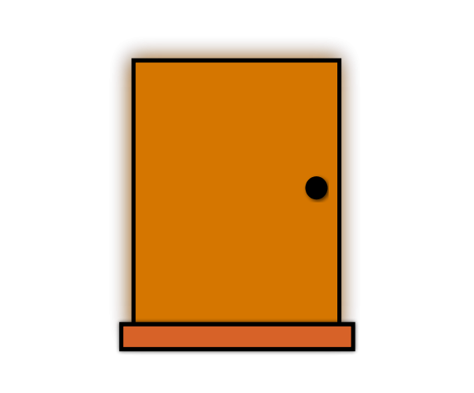


Implementation
Used Techniques

Slide 33

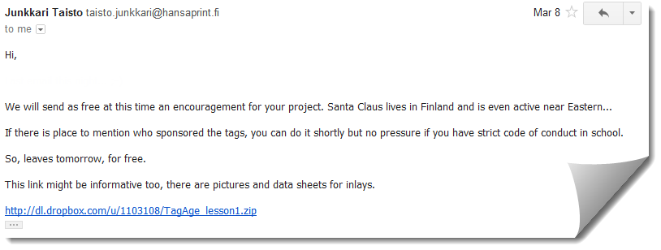

Implementation
Used Techniques

Slide 34
Implementation
Earning money

Slide 35


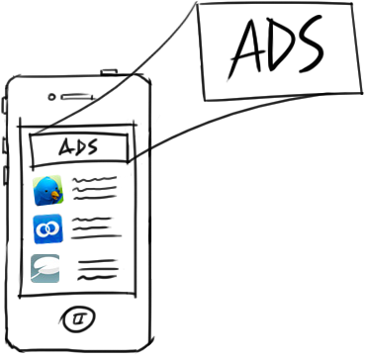

Implementation
Earning money

Slide 36
Implementation
Used Tools

Slide 37






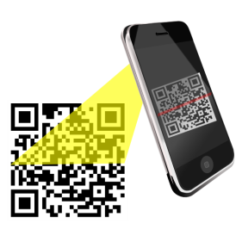

Implementation
Used Tools
Ksoap

Slide 38
Implementation
Difficulties we have faced

Slide 39

Implementation
Difficulties
Ram: 3 GB
Processor : Core I3
Ram: 300 MB Processor : 528 MHz

Slide 40
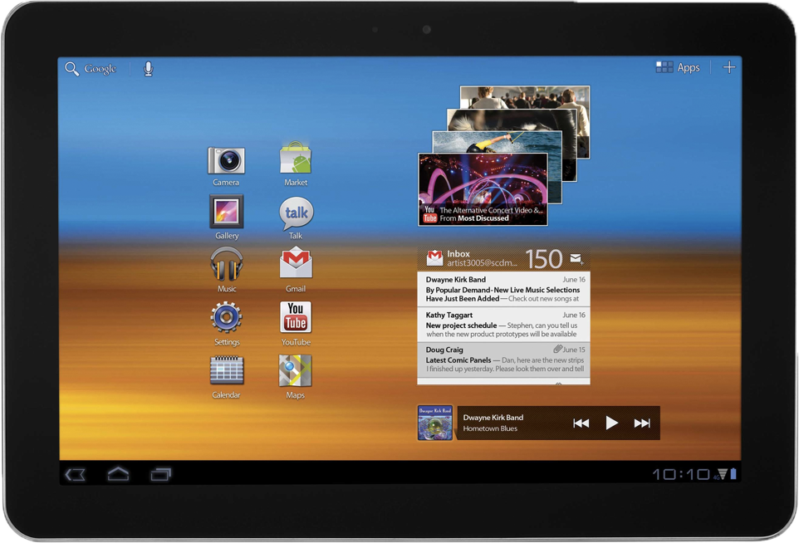
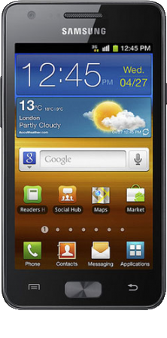
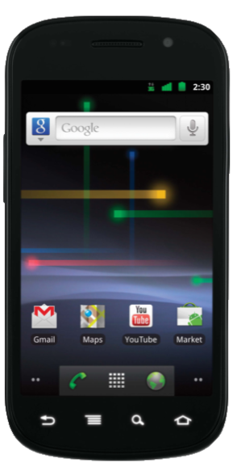
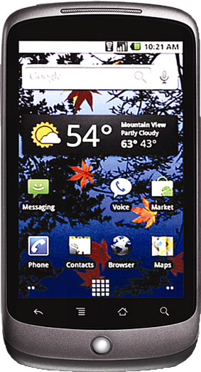
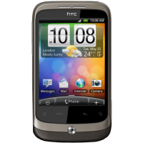
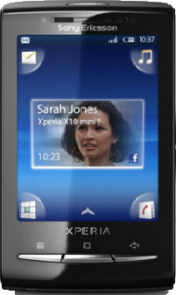
Implementation
Difficulties

Slide 41
Implementation
Publishing & Statistics

Slide 42




Implementation
Publishing & Statistics

Slide 43

Implementation
Publishing & Statistics
Mobile app downloaded: 3000
Number of users: 1100
Number of developers: 200
Number of apps: 300
Number of rates: 500
Number of installs: 3400

Slide 44
Implementation
Images From App Mobile & Website

Slide 45
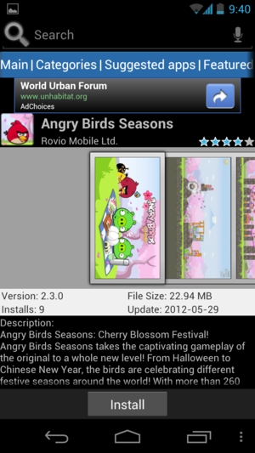
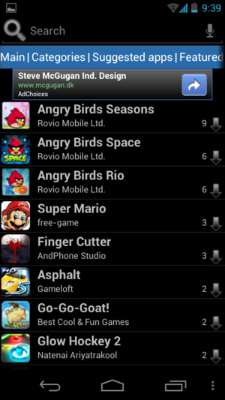
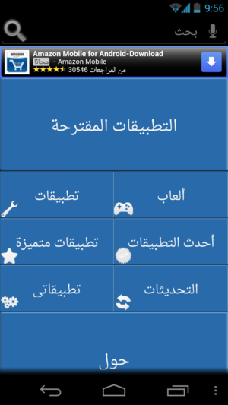
Implementation
Images From App

Slide 46
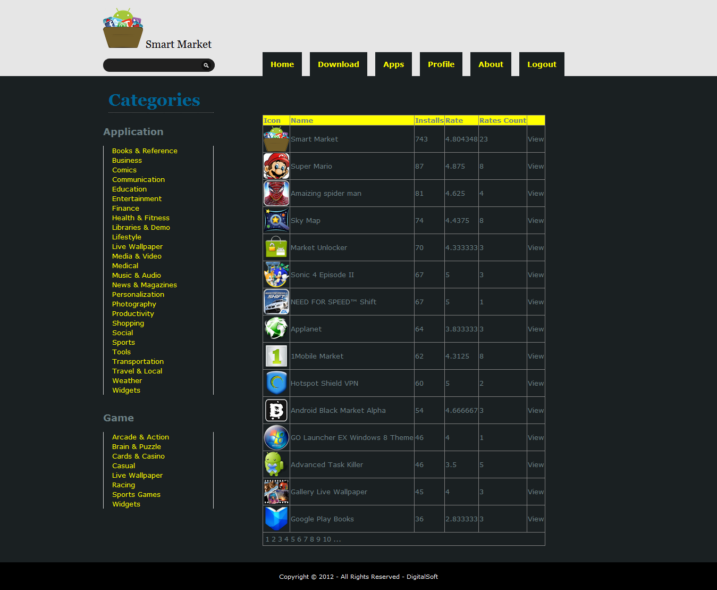
Implementation
Images From Web

Slide 47
Future Plans
Implementation
Contents

Slide 48

Future Plans
More accurate search algorithms and filtered results;
Marketing to the NFC technology;
Increase the number of applications in the market;
Allow users to add their comments for the applications that they have installed ;
Allow users to upload apps directly from their phones.

Slide 49
Let’s start
demo

